Slide 1

HR Attrition Analysis
Emily Jewell
DAT 430 Project Two
December 9, 2024
emily.jewell@snhu.edu

Slide 2
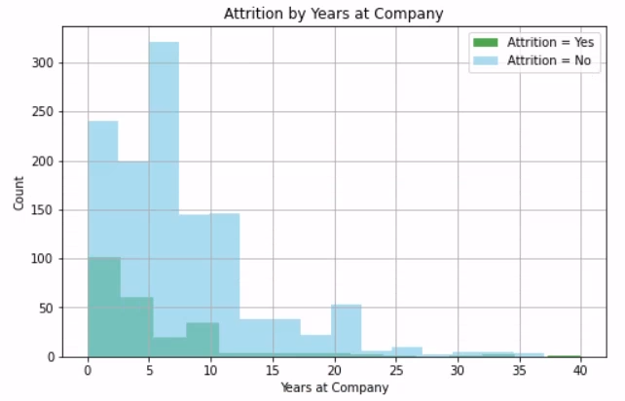
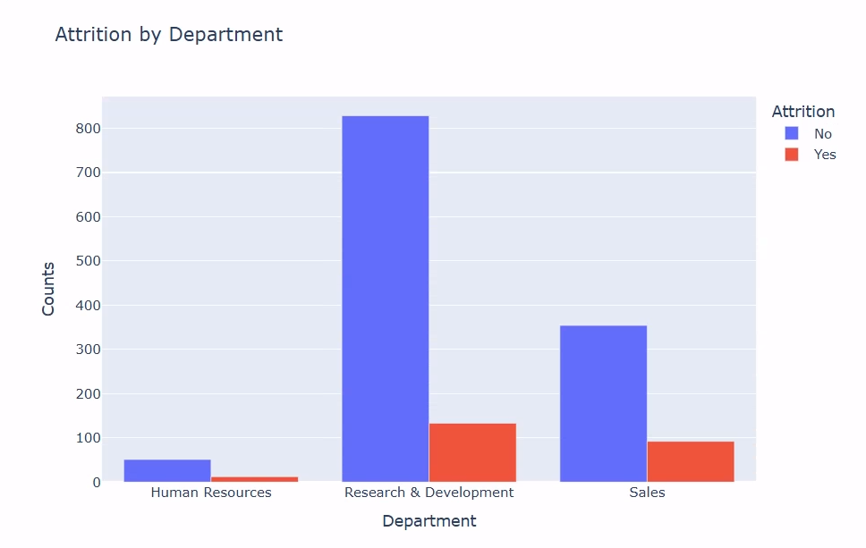
HR Attrition Data
The longer employees are at the company, the more likely they are to stay long term.
The sales department has the highest proportion of employees leaving compared to the other two departments.
Employees stay with the company an average of 7 years.

Slide 3
Regression Model
The regression model achieved 100% accuracy meaning we can correctly predict employee attrition based on historical data.
This model doesn't, however, show us the variables that contribute to attrition.

Slide 4
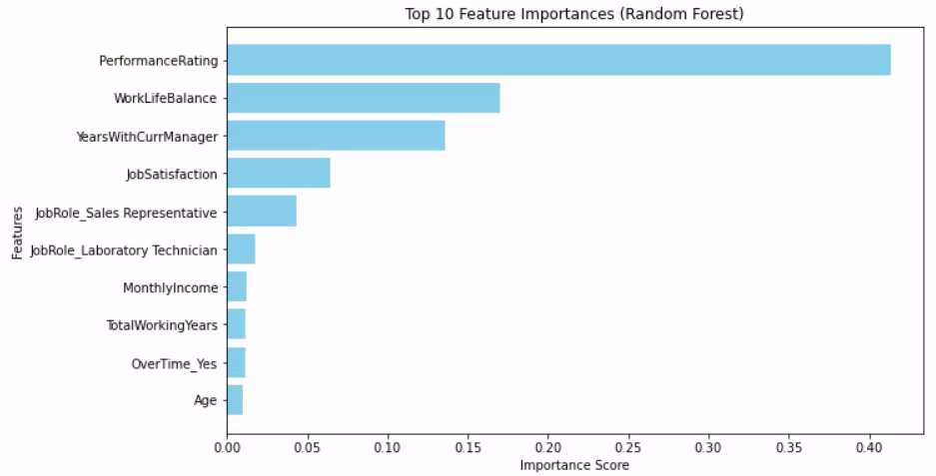
Random Forest Model
The random forest model also predicted attrition with 100% accuracy and was also able to show us which variables are the most important in contributing to attrition as shown in the visual below:

Slide 5
Actionable Insights
Examine the process and structure of the company's performance review procedures looking for ways to motivate employees in a positive way.
Provide opportunities for days off and remote work scenarios while emphasizing the importance of a work-home life balance.
Look into the sales department's daily workflow to determine what can be improved upon to retain employees there.

